Slide 1

Artificial Intelligence: A Modern Approach
Fourth Edition, Global Edition
Chapter 13
Probabilistic Reasoning
© 2022 Pearson Education Ltd.

Slide 2
Outline
Representing Knowledge in an Uncertain Domain
Semantics of Bayesian Networks
Exact Inference in Bayesian Networks
Approximate Inference for Bayesian Networks
Causal Networks
© 2022 Pearson Education Ltd.

Slide 3
Representing Knowledge in an Uncertain Domain
Bayesian networks: represents dependencies among variables.
A simple, directed graph in which each node is annotated with quantitative probability information
Syntax:
a set of nodes, one per variable
a directed, acyclic graph (link ≈ “directly influences”)
a conditional distribution for each node given its parents:
P(X_{i}|Parents(X_{i}))
In the simplest case, conditional distribution represented as a conditional probability table (CPT) giving the distribution over X_{i} for each combination of parent values
© 2022 Pearson Education Ltd.

Slide 4
Example
Topology of network encodes conditional independence assertions:
Weather
Cavity
Toothache
Catch
W eather is independent of the other variables
T oothache and Catch are conditionally independent given Cavity
© 2022 Pearson Education Ltd.

Slide 5
Example
I’m at work, neighbor John calls to say my alarm is ringing, but neighbor Mary doesn’t call. Sometimes it’s set off by minor earthquakes. Is there a burglar?
Variables: Burglar, Earthquake, Alarm, J ohnCalls, MaryCalls
Network topology reflects “causal” knowledge:
A burglar can set the alarm off
An earthquake can set the alarm off
The alarm can cause Mary to call
The alarm can cause John to call
© 2022 Pearson Education Ltd.

Slide 6
Example contd.
P(B)
P(E)
Burglary
.001
Earthquake
.002
B | E | P(A|B,E)
T | T | .95
T | F | .94
F | T | .29
F | F | .001
Alarm
A | P(J|A)
T F | .90 .05
A | P(M|A)
T F | .70 .01
JohnCalls
MaryCalls
© 2022 Pearson Education Ltd.

Slide 7
Compactness
A CPT for Boolean X_{i} with k Boolean parents has
2^{k} rows for the combinations of parent values
Each row requires one number p for X_{i} = true
(the number for X_{i} = false is just 1 − p)
If each variable has no more than k parents,
the complete network requires O(n · 2^{k}) numbers
I.e., grows linearly with n, vs. O(2^{n}) for the full joint distribution
B
E
A
J
M
For burglary net, 1 + 1 + 4 + 2 + 2 = 10 numbers (vs. 2⁵ − 1 = 31)
© 2022 Pearson Education Ltd.

Slide 8
The Semantics of Bayesian Networks
Global semantics defines the full joint distribution as the product of the local conditional distributions:
B
E
P (x , . . . , x ) = Π^{n}
P (x_{i}|parents(X_{i}))
A
1 n
i = 1
e.g., P (j ∧ m ∧ a ∧ ¬b ∧ ¬e)
=
J
M
© 2022 Pearson Education Ltd.

Slide 9
Global semantics
“Global” semantics defines the full joint distribution as the product of the local conditional distributions:
B
E
P (x , . . . , x ) = Π^{n}
P (x_{i}|parents(X_{i}))
A
1 n
i = 1
e.g., P (j ∧ m ∧ a ∧ ¬b ∧ ¬e)
= P (j|a)P (m|a)P (a|¬b, ¬e)P (¬b)P (¬e)
= 0.9 × 0.7 × 0.001 × 0.999 × 0.998
≈ 0.00063
J
M
© 2022 Pearson Education Ltd.

Slide 10
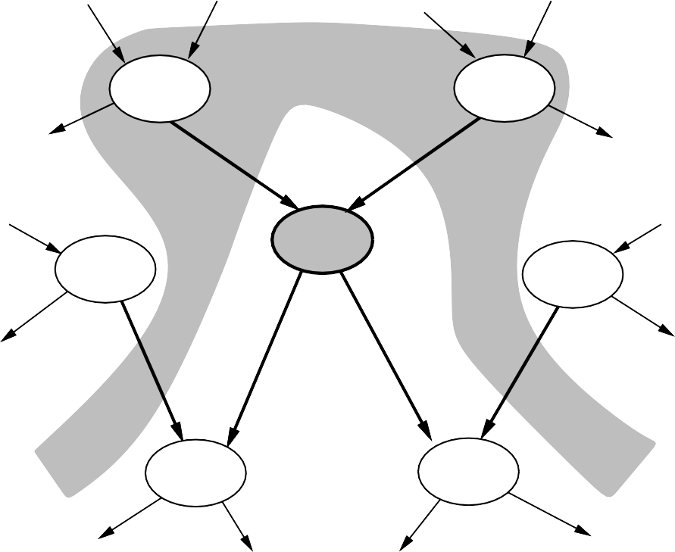
Local semantics
Local semantics: each node is conditionally independent of its nondescendants given its parents
U₁
. . .
U_{m}
X
^{Z} 1j
^{Z}nj
Y₁
. . .
Y_{n}
Theorem: Local semantics ⇔ global semantics
© 2022 Pearson Education Ltd.

Slide 11
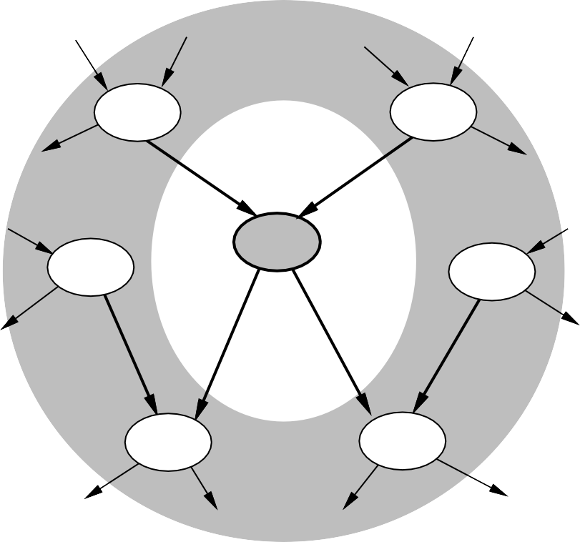
Markov blanket
Each node is conditionally independent of all others given its Markov blanket: parents + children + children’s parents
U₁
. . .
U_{m}
X
^{Z} 1j
^{Z}nj
Y₁
. . .
Y_{n}
© 2022 Pearson Education Ltd.

Slide 12
Constructing Bayesian networks
Need a method such that a series of locally testable assertions of conditional independence guarantees the required global semantics
Choose an ordering of variables X₁, . . . , X_{n}
For i = 1 to n
add X_{i} to the network
select parents from X₁, . . . , X_{i−1} such that
P(X_{i}|Parents(X_{i})) = P(X_{i}|X₁, . . . , X_{i−1})
This choice of parents guarantees the global semantics:
P(X , . . . , X ) = Π^{n}
P(X |X , . . . , X )
(chain rule)
(by construction)
1 n
i = 1
i 1 i−1
= Π^{n} P(X |Parents(X ))
i = 1
i
i
© 2022 Pearson Education Ltd.

Slide 13
Example
Suppose we choose the ordering M , J , A, B, E
MaryCalls
JohnCalls
P (J |M ) = P (J )?
© 2022 Pearson Education Ltd.

Slide 14
Example
Suppose we choose the ordering M , J , A, B, E
MaryCalls
JohnCalls
Alarm
P (J |M ) = P (J )? No
P (A|J, M ) = P (A|J )? P (A|J, M ) = P (A)?
© 2022 Pearson Education Ltd.

Slide 15
Example
Suppose we choose the ordering M , J , A, B, E
MaryCalls
JohnCalls
Alarm
Burglary
P (J |M ) = P (J )? No
P (A|J, M ) = P (A|J )? P (A|J, M ) = P (A)? No
P (B|A, J, M ) = P (B|A)?
P (B|A, J, M ) = P (B)?
© 2022 Pearson Education Ltd.

Slide 16
Example
Suppose we choose the ordering M , J , A, B, E
MaryCalls
JohnCalls
Alarm
Burglary
Earthquake
P (J |M ) = P (J )? No
P (A|J, M ) = P (A|J )? P (A|J, M ) = P (A)? No
P (B|A, J, M ) = P (B|A)? Yes
P (B|A, J, M ) = P (B)? No
P (E|B, A, J, M ) = P (E|A)?
P (E|B, A, J, M ) = P (E|A, B)?
© 2022 Pearson Education Ltd.

Slide 17
Example
Suppose we choose the ordering M , J , A, B, E
MaryCalls
JohnCalls
Alarm
Burglary
Earthquake
P (J |M ) = P (J )? No
P (A|J, M ) = P (A|J )? P (A|J, M ) = P (A)? No
P (B|A, J, M ) = P (B|A)? Yes
P (B|A, J, M ) = P (B)? No
P (E|B, A, J, M ) = P (E|A)? No
P (E|B, A, J, M ) = P (E|A, B)? Yes
© 2022 Pearson Education Ltd.
17

Slide 18
Example contd.
MaryCalls
JohnCalls
Alarm
Burglary
Earthquake
Deciding conditional independence is hard in noncausal directions
(Causal models and conditional independence seem hardwired for humans!) Assessing conditional probabilities is hard in noncausal directions
Network is less compact: 1 + 2 + 4 + 2 + 4 = 13 numbers needed
© 2022 Pearson Education Ltd.

Slide 19
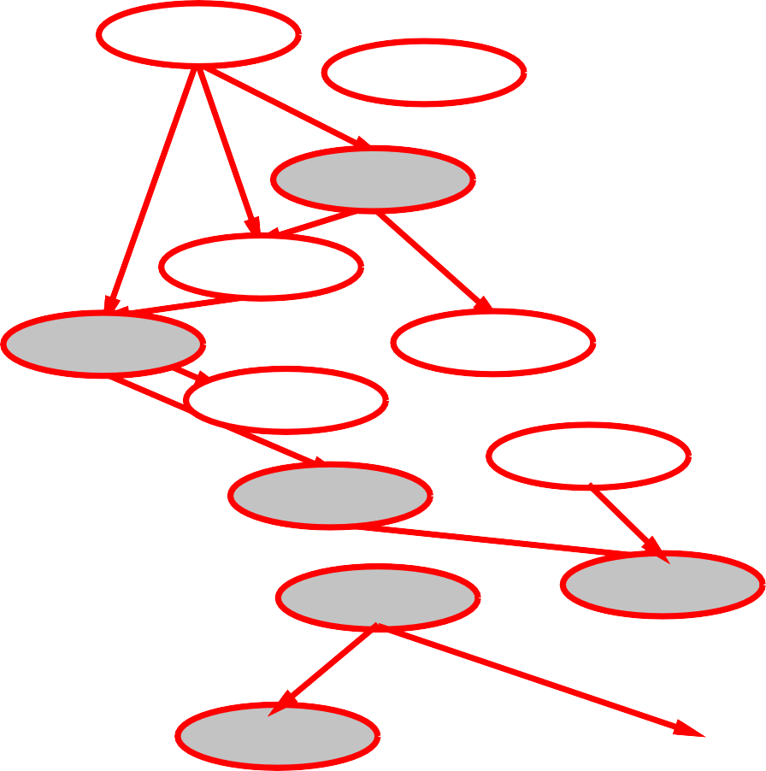
Example: Car insurance
SocioEcon
Age
GoodStudent
ExtraCar
Mileage
RiskAversion
VehicleYear
SeniorTrain
DrivingSkill
MakeModel
DrivingHist
Antilock
DrivQuality
Airbag
CarValue
HomeBase
AntiTheft
Ruggedness
Accident
Theft
OwnDamage
Cushioning
OtherCost
OwnCost
MedicalCost
LiabilityCost
PropertyCost
© 2022 Pearson Education Ltd.

Slide 20
Compact conditional distributions
CPT grows exponentially with number of parents
CPT becomes infinite with continuous-valued parent or child
Solution: canonical distributions that are defined compactly Deterministic nodes are the simplest case:
X = f (Parents(X)) for some function f
E.g., Boolean functions
N orthAmerican ⇔ Canadian ∨ US ∨ M exican
E.g., numerical relationships among continuous variables
∂Level
= inflow + precipitation - outflow - evaporation
∂t
© 2022 Pearson Education Ltd.

Slide 21
Compact conditional distributions contd.
Noisy-OR distributions model multiple noninteracting causes
Parents U₁ . . . U_{k} include all causes (can add leak node)
Independent failure probability q_{i} for each cause alone
j
⇒ P (X|U . . . U , ¬
U . . . ¬
U ) = 1 − Π q
1
j j+1
k
i = 1
i
Cold | Flu | Malaria | P (F ever) | P (¬F ever)
F F F F T T T T | F F T T F F T T | F T F T F T F T | 0.0 0.9 0.8 0.98 0.4 0.94 0.88 0.988 | 1.0 0.1 0.2 0.02 = 0.2 × 0.1 0.6 0.06 = 0.6 × 0.1 0.12 = 0.6 × 0.2 0.012 = 0.6 × 0.2 × 0.1
Number of parameters linear in number of parents
© 2022 Pearson Education Ltd.

Slide 22
Hybrid (discrete+continuous) networks
Discrete (Subsidy? and Buys?); continuous (Harvest and Cost)
Subsidy?
Harvest
Cost
Buys?
Option 1: discretization—possibly large errors, large CPTs Option 2: finitely parameterized canonical families
Continuous variable, discrete+continuous parents (e.g., Cost)
Discrete variable, continuous parents (e.g., Buys?)
© 2022 Pearson Education Ltd.

Slide 23
Continuous child variables
Need one conditional density function for child variable given continuous parents, for each possible assignment to discrete parents
Most common is the linear Gaussian model, e.g.,:
P (Cost = c|Harvest = h, Subsidy? = true)
= N (a_{t}h + b_{t}, σ_{t})(c)



2

1 1 c − (a h + b ) 
=
√
exp −

t t
 


σ 2π

2 σ
t t
Mean Cost varies linearly with Harvest, variance is fixed
Linear variation is unreasonable over the full range
but works OK if the likely range of Harvest is narrow
© 2022 Pearson Education Ltd.

Slide 24
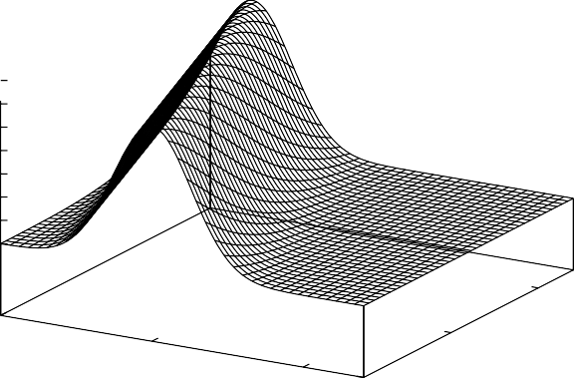
Continuous child variables
P(Cost|Harvest,Subsidy?=true)
0.35
0.3
0.25
0.2
0.15
0.1
0.05
0
10
Harvest
0
5
Cost
5
10
0
All-continuous network with LG distributions
⇒ full joint distribution is a multivariate Gaussian
Discrete+continuous LG network is a conditional Gaussian network i.e., a multivariate Gaussian over all continuous variables for each combination of discrete variable values
© 2022 Pearson Education Ltd.

Slide 25
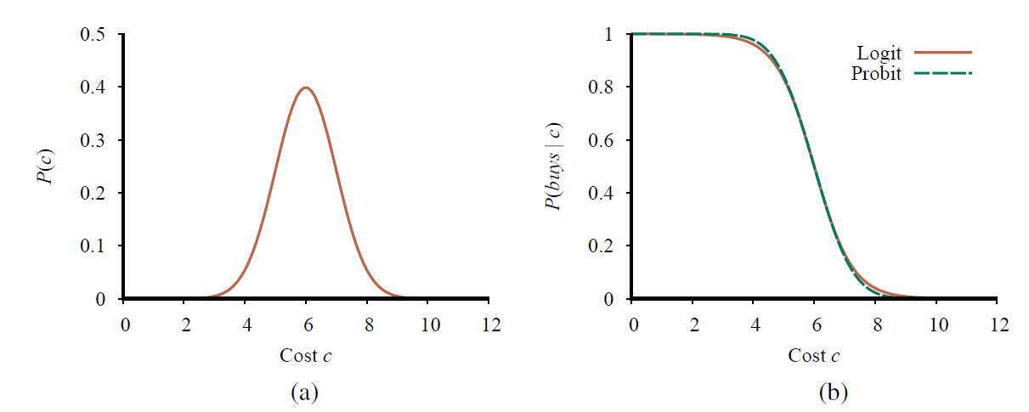
Discrete variable w/ continuous parents
Probability of Buys? given Cost should be a “soft” threshold:
(a) A normal (Gaussian) distribution for the cost threshold, centered on µ = 6.0 with standard deviation σ = 1.0. (b) Expit and probit models for the probability of buys given cost, for the parameters µ = 6.0 and σ = 1.0.
Probit distribution uses integral of Gaussian:
Φ(x) =
J
x
N (0, 1)(x)dx
−∞
P (Buys? = true | Cost = c) = Φ((−c + µ)/σ)
© 2022 Pearson Education Ltd.

Slide 26
Why the probit?
It’s sort of the right shape
Can view as hard threshold whose location is subject to noise
Cost
Cost
Noise
Buys?
© 2022 Pearson Education Ltd.

Slide 27
Discrete variable contd.
Sigmoid (or logit) distribution also used in neural networks:
1
1 + exp(−2
P (Buys? = true | Cost = c) =
−c+µ
)
σ
Sigmoid has similar shape to probit but much longer tails:
1
0.9
0.8
0.7
0.6
0.5
0.4
0.3
0.2
0.1
0
P(Buys?=false|Cost=c)
0
2
4
6
Cost c
8
10
12
© 2022 Pearson Education Ltd.

Slide 28
Exact Inference in Bayesian Networks
Simple queries: compute posterior marginal P(X_{i}|E = e)
e.g., P (N oGas|Gauge = empty, Lights = on, Starts = false)
Conjunctive queries: P(X_{i}, X_{j}|E = e) = P(X_{i}|E = e)P(X_{j}|X_{i}, E = e)
Optimal decisions: decision networks include utility information; probabilistic inference required for P (outcome|action, evidence)
Value of information: which evidence to seek next? Sensitivity analysis: which probability values are most critical? Explanation: why do I need a new starter motor?

Slide 29
Inference by enumeration
Slightly intelligent way to sum out variables from the joint without actually constructing its explicit representation
Simple query on the burglary network:
P(B|j, m)
B
E
= P(B, j, m)/P (j, m)
A
= αP(B, j, m)
= α Σ_{e} Σ_{a} P(B, e, a, j, m)
Rewrite full joint entries using product of CPT entries:
J
M
P(B|j, m)
= α Σ_{e} Σ_{a} P(B)P (e)P(a|B, e)P (j|a)P (m|a)
= αP(B) Σ_{e} P (e) Σ_{a} P(a|B, e)P (j|a)P (m|a)
Recursive depth-first enumeration: O(n) space, O(d^{n}) time

Slide 30
Enumeration algorithm
function Enumeration-Ask(X, e, bn) returns a distribution over X
inputs: X, the query variable
e, observed values for variables E
bn, a Bayesian network with variables {X} ∪ E ∪ Y
Q(X ) ← a distribution over X, initially empty
for each value x_{i} of X do
extend e with value x_{i} for X
Q(x_{i} ) ← Enumerate-All(Vars[bn], e) return Normalize(Q(X ))
function Enumerate-All(vars, e) returns a real number
if Empty?(vars) then return 1.0
Y ← First(vars)
if Y has value y in e
then return P (y | Pa(Y )) × Enumerate-All(Rest(vars), e) else return _{y} P (y | Pa(Y )) × Enumerate-All(Rest(vars), e_{y} )
where e_{y} is e extended with Y = y

Slide 31

Evaluation tree
P(b)
.001
P(e)
.002
P( e)
.998
P(a|b,e)
.95
P( a|b,e)
.05
P(a|b, e)
.94
P( a|b, e)
.06
P(j|a)
.90
P(j| a)
.05
P(j|a)
.90
P(j| a)
.05
P(m|a)
.70
P(m| a)
.01
P(m|a)
.70
P(m| a)
.01
Enumeration is inefficient: repeated computation e.g., computes P (j|a)P (m|a) for each value of e

Slide 32
Inference by variable elimination
Variable elimination: carry out summations right-to-left, storing intermediate results (factors) to avoid recomputation
P(B|j, m)
= α P(B) Σ_{e} P (e) Σ_{a} P(a|B, e) P (j|a) P (m|a)
_{B}
_{E}
_{A} _{J} _{M}
= αP(B)Σ_{e}P (e)Σ_{a}P(a|B, e)P (j|a)f_{M} (a)
= αP(B)Σ_{e}P (e)Σ_{a}P(a|B, e)f_{J} (a)f_{M} (a)
= αP(B)Σ_{e}P (e)Σ_{a}f_{A}(a, b, e)f_{J} (a)f_{M} (a)
= αP(B)ΣeP (e)f_{A}¯_{J M} (b, e) (sum out A)
= αP(B)f_{E}¯_{A}¯_{J M} (b) (sum out E)
= αfB(b) × f_{E}¯_{A}¯_{J M} (b)

Slide 33
Variable elimination: Basic operations
Summing out a variable from a product of factors: move any constant factors outside the summation
add up submatrices in pointwise product of remaining factors
Σxf1 × · · · × fk = f1 × · · · × fi Σx fi+1 × · · · × fk = f1 × · · · × fi × f_{X}¯
assuming f₁, . . . , f_{i} do not depend on X
Pointwise product of factors f₁ and f₂:
f₁(x₁, . . . , x_{j}, y₁, . . . , y_{k}) × f₂(y₁, . . . , y_{k}, z₁, . . . , z_{l})
= f (x₁, . . . , x_{j}, y₁, . . . , y_{k}, z₁, . . . , z_{l})
E.g., f₁(a, b) × f₂(b, c) = f (a, b, c)

Slide 34
Variable elimination algorithm
function Elimination-Ask(X, e, bn) returns a distribution over X
inputs: X, the query variable
e, evidence specified as an event
bn, a belief network specifying joint distribution P(X₁, . . . , X_{n})
factors ← [ ]; vars ← Reverse(Vars[bn])
for each var in vars do
factors ← [Make-Factor(var , e)|factors]
if var is a hidden variable then factors ← Sum-Out(var, factors)
return Normalize(Pointwise-Product(factors))

Slide 35
Irrelevant variables
Consider the query P (J ohnCalls|Burglary = true)
B
E
P (J |b) = αP (b) _{e} P (e) _{a} P (a|b, e)P (J |a) _{m} P (m|a)
Sum over m is identically 1; M is irrelevant to the query
A
J
M
Thm 1: Y is irrelevant unless Y ∈ Ancestors({X} ∪ E)
Here, X = J ohnCalls, E = {Burglary}, and Ancestors({X} ∪ E) = {Alarm, Earthquake} so MaryCalls is irrelevant
(Compare this to backward chaining from the query in Horn clause KBs)

Slide 36
Irrelevant variables contd.
Defn: moral graph of Bayes net: marry all parents and drop arrows
Defn: A is m-separated from B by C iff separated by C in the moral graph Thm 2: Y is irrelevant if m-separated from X by E
B
E
For P (J ohnCalls|Alarm = true), both
A
Burglary and Earthquake are irrelevant
J
M

Slide 37
Complexity of exact inference
Singly connected networks (or polytrees):
any two nodes are connected by at most one (undirected) path
time and space cost of variable elimination are O(d^{k}n)
Multiply connected networks:
can reduce 3SAT to exact inference ⇒ NP-hard
equivalent to counting 3SAT models ⇒ #P-complete
0.5
A
0.5
B
0.5
C
0.5
D
1. A v B v C
C v D v A
B v C v D
1
2
3
AND

Slide 38
Approximate Inference for Bayesian Networks
Basic idea:
Draw N samples from a sampling distribution S
Compute an approximate posterior probability P^{ˆ}
Show this converges to the true probability P
0.5
Coin
Outline:
Sampling from an empty network
Rejection sampling: reject samples disagreeing with evidence
Likelihood weighting: use evidence to weight samples
– Markov chain Monte Carlo (MCMC): sample from a stochastic process whose stationary distribution is the true posterior

Slide 39
Sampling from an empty network
function Prior-Sample(bn) returns an event sampled from bn
inputs: bn, a belief network specifying joint distribution P(X₁, . . . , X_{n})
x ← an event with n elements
for i = 1 to n do
x_{i} ← a random sample from P(X_{i} | parents(X_{i}))
given the values of Parents(X_{i}) in x return x

Slide 40
Example
P(C)
.50
Cloudy
C | P(S|C)
T | .10
F | .50
C | P(R|C)
T | .80
F | .20
Sprinkler
Rain
Wet Grass
S | R | P(W|S,R)
T | T | .99
T | F | .90
F | T | .90
F | F | .01

Slide 41
Example
P(C)
.50
Cloudy
C | P(S|C)
T | .10
F | .50
C | P(R|C)
T | .80
F | .20
Sprinkler
Rain
Wet Grass
S | R | P(W|S,R)
T | T | .99
T | F | .90
F | T | .90
F | F | .01

Slide 42
Example
P(C)
.50
Cloudy
C | P(S|C)
T F |  | .10
 | .50
C | P(R|C)
T F | .80 .20
Sprinkler
Rain
Wet Grass
S | R | P(W|S,R)
T | T | .99
T | F | .90
F | T | .90
F | F | .01

Slide 43
Example
P(C)
.50
Cloudy
C | P(S|C)
T F |  | .10
 | .50
C | P(R|C)
T F | .80 .20
Sprinkler
Rain
Wet Grass
S | R | P(W|S,R)
T | T | .99
T | F | .90
F | T | .90
F | F | .01

Slide 44
Example
P(C)
.50
Cloudy
C | P(S|C)
T F |  | .10
 | .50
C | P(R|C)
T F | .80 .20
Sprinkler
Rain
Wet Grass
S | R | P(W|S,R)
T | T | .99
T | F | .90
F | T | .90
F | F | .01

Slide 45
Example
P(C)
.50
Cloudy
C | P(S|C)
T F |  | .10
 | .50
C | P(R|C)
T F | .80 .20
Sprinkler
Rain
Wet Grass
S | R | P(W|S,R)
T | T | .99
T | F | .90
F | T |  | .90
F | F | .01

Slide 46
Example
P(C)
.50
Cloudy
C | P(S|C)
T F |  | .10
 | .50
C | P(R|C)
T F | .80 .20
Sprinkler
Rain
Wet Grass
S | R | P(W|S,R)
T | T | .99
T | F | .90
F | T |  | .90
F | F | .01

Slide 47
Sampling from an empty network contd.
Probability that PriorSample generates a particular event
S (x . . . x ) = Π^{n} P (x |parents(X )) = P (x . . . x )
PS 1 n
i = 1
i i 1 n
i.e., the true prior probability
E.g., S_{PS} (t, f, t, t) = 0.5 × 0.9 × 0.8 × 0.9 = 0.324 = P (t, f, t, t)
Let N_{PS} (x₁ . . . x_{n}) be the number of samples generated for event x₁, . . . , x_{n}
Then we have
lim P^{ˆ}(x₁, . . . , x_{n}) = lim N_{PS} (x₁, . . . , x_{n})/N
N →∞ N →∞
= S_{PS} (x₁, . . . , x_{n})
= P (x₁ . . . x_{n})
That is, estimates derived from PriorSample are consistent Shorthand: P^{ˆ}(x₁, . . . , x_{n}) ≈ P (x₁ . . . x_{n})

Slide 48
Rejection sampling
P^{ˆ}(X|e) estimated from samples agreeing with e
function Rejection-Sampling(X, e, bn, N) returns an estimate of P (X |e)
local variables: N, a vector of counts over X, initially zero
for j = 1 to N do
x ← Prior-Sample(bn)
if x is consistent with e then
N[x] ← N[x]+1 where x is the value of X in x return Normalize(N[X])
E.g., estimate P(Rain|Sprinkler = true) using 100 samples 27 samples have Sprinkler = true
Of these, 8 have Rain = true and 19 have Rain = false.
P^{ˆ}(Rain|Sprinkler = true) = Normalize((8, 19)) = (0.296, 0.704)
Similar to a basic real-world empirical estimation procedure

Slide 49
Analysis of rejection sampling
P^{ˆ}(X|e) = αN_{PS} (X, e)
(algorithm defn.) (normalized by N_{PS} (e))
(property of PriorSample)
= N_{PS} (X, e)/N_{P S} (e)
≈ P(X, e)/P (e)
= P(X|e) (defn. of conditional probability)
Hence rejection sampling returns consistent posterior estimates Problem: hopelessly expensive if P (e) is small
P (e) drops off exponentially with number of evidence variables!

Slide 50
Likelihood weighting
Idea: fix evidence variables, sample only nonevidence variables, and weight each sample by the likelihood it accords the evidence
function Likelihood-Weighting(X, e, bn, N) returns an estimate of P (X |e)
local variables: W, a vector of weighted counts over X, initially zero
for j = 1 to N do
x, w ← Weighted-Sample(bn)
W[x ] ← W[x ] + w where x is the value of X in x return Normalize(W[X ])
function Weighted-Sample(bn, e) returns an event and a weight
x ← an event with n elements; w ← 1
for i = 1 to n do
if X_{i} has a value x_{i} in e
then w ← w × P (X_{i} = x_{i} | parents(X_{i} ))
else x_{i} ← a random sample from P(X_{i} | parents(X_{i} ))
return x, w

Slide 51
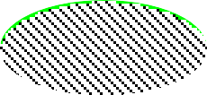

Likelihood weighting example
P(C)
.50
Cloudy
C | P(S|C)
T | .10
F | .50
C | P(R|C)
T | .80
F | .20
Sprinkler
Rain
Wet Grass
S | R | P(W|S,R)
T | T | .99
T | F | .90
F | T | .90
F | F | .01
w = 1.0

Slide 52
Likelihood weighting example
P(C)
.50
Cloudy
C | P(S|C)
T | .10
F | .50
C | P(R|C)
T | .80
F | .20
Sprinkler
Rain
Wet Grass
S | R | P(W|S,R)
T | T | .99
T | F | .90
F | T | .90
F | F | .01
w = 1.0

Slide 53
Likelihood weighting example
P(C)
.50
Cloudy
C | P(S|C)
T F | .10
 | .50
C | P(R|C)
T F | .80
 | .20
Sprinkler
Rain
Wet Grass
S | R | P(W|S,R)
T | T | .99
T | F | .90
F | T | .90
F | F | .01
w = 1.0

Slide 54
Likelihood weighting example
P(C)
.50
Cloudy
C | P(S|C)
T F | .10
 | .50
C | P(R|C)
T F | .80
 | .20
Sprinkler
Rain
Wet Grass
S | R | P(W|S,R)
T | T | .99
T | F | .90
F | T | .90
F | F | .01
w = 1.0 × 0.1

Slide 55
Likelihood weighting example
P(C)
.50
Cloudy
C | P(S|C)
T F | .10
 | .50
C | P(R|C)
T F | .80
 | .20
Sprinkler
Rain
Wet Grass
S | R | P(W|S,R)
T | T | .99
T | F | .90
F | T | .90
F | F | .01
w = 1.0 × 0.1

Slide 56
Likelihood weighting example
P(C)
.50
Cloudy
C | P(S|C)
T F | .10
 | .50
C | P(R|C)
T F | .80
 | .20
Sprinkler
Rain
Wet Grass
S | R | P(W|S,R)
T | T | .99
T | F | .90
F | T | .90
F | F | .01
w = 1.0 × 0.1

Slide 57
Likelihood weighting example
P(C)
.50
Cloudy
C | P(S|C)
T F | .10
 | .50
C | P(R|C)
T F | .80
 | .20
Sprinkler
Rain
Wet Grass
S | R | P(W|S,R)
T | T | .99
T | F | .90
F | T | .90
F | F | .01
w = 1.0 × 0.1 × 0.99 = 0.099

Slide 58


Likelihood weighting analysis
Sampling probability for WeightedSample is
S (z, e) = Π^{l} P (z |parents(Z ))
WS
i = 1
i i
Note: pays attention to evidence in ancestors only
⇒ somewhere “in between” prior and posterior distribution
Cloudy
Sprinkler
Rain
Weight for a given sample z, e is
Wet Grass
w(z, e) = Π^{m} P (e |parents(E ))
i = 1
i i
Weighted sampling probability is
S_{WS} (z, e)w(z, e)
= Π^{l} P (z |parents(Z ))
_{Π}m
P (e |parents(E ))
i i i i
i = 1 i = 1
= P (z, e) (by standard global semantics of network)
Hence likelihood weighting returns consistent estimates
but performance still degrades with many evidence variables because a few samples have nearly all the total weight

Slide 59
Approximate inference using MCMC
“State” of network = current assignment to all variables.
Generate next state by sampling one variable given Markov blanket Sample each variable in turn, keeping evidence fixed
function MCMC-Ask(X, e, bn, N) returns an estimate of P (X |e)
local variables: N[X ], a vector of counts over X, initially zero
Z, the nonevidence variables in bn
x, the current state of the network, initially copied from e
initialize x with random values for the variables in Y for j = 1 to N do
for each Z_{i} in Z do
sample the value of Z_{i} in x from P(Z_{i} |mb(Z_{i} ))
given the values of MB(Z_{i} ) in x
N[x ] ← N[x ] + 1 where x is the value of X in x return Normalize(N[X ])
Can also choose a variable to sample at random each time

Slide 60






The Markov chain
With Sprinkler = true, W etGrass = true, there are four states:
Cloudy
Cloudy
Sprinkler
Rain
Sprinkler
Rain
Wet Grass
Wet Grass
Cloudy
Cloudy
Sprinkler
Rain
Sprinkler
Rain
Wet Grass
Wet Grass
Wander about for a while, average what you see

Slide 61
MCMC example contd.
Estimate P(Rain|Sprinkler = true, W etGrass = true)
Sample Cloudy or Rain given its Markov blanket, repeat. Count number of times Rain is true and false in the samples.
E.g., visit 100 states
31 have Rain = true, 69 have Rain = false
P^{ˆ}(Rain|Sprinkler = true, W etGrass = true)
= Normalize((31, 69)) = (0.31, 0.69)
Theorem: chain approaches stationary distribution:
long-run fraction of time spent in each state is exactly proportional to its posterior probability

Slide 62


Markov blanket sampling
Markov blanket of Cloudy is
Sprinkler and Rain
Markov blanket of Rain is
Cloudy, Sprinkler, and W etGrass
Cloudy
Sprinkler
Rain
Wet Grass
Probability given the Markov blanket is calculated as follows:
P (x _{i}|mb(X_{i})) = P (x _{i}|parents(X_{i}))Π_{Zj ∈Children(Xi)}P (z_{j}|parents(Z_{j}))
Easily implemented in message-passing parallel systems, brains Main computational problems:
Difficult to tell if convergence has been achieved
Can be wasteful if Markov blanket is large:
P (X_{i}|mb(X_{i})) won’t change much (law of large numbers)

Slide 63
Causal Networks
Causal Networks: a restricted class of Bayesian networks that forbids
all but causally compatible orderings.
P(c, r, s, w, g) = P(c) P(r |c) P(s|c) P(w|r, s) P(g|w)
C = f_{C}(U_{C})
R = f_{R}(C,U_{R})
S = f_{S}(C,U_{S})
W = f_{W} (R, S,U_{W} )
G = f_{G}(W,U_{G})
For example, suppose we turn the sprinkler on—do(Sprinkler = true)
P(c, r, w, g|do(S = true)) = P(c) P(r |c) P(w|r, s = true) P(g|w)

Slide 64
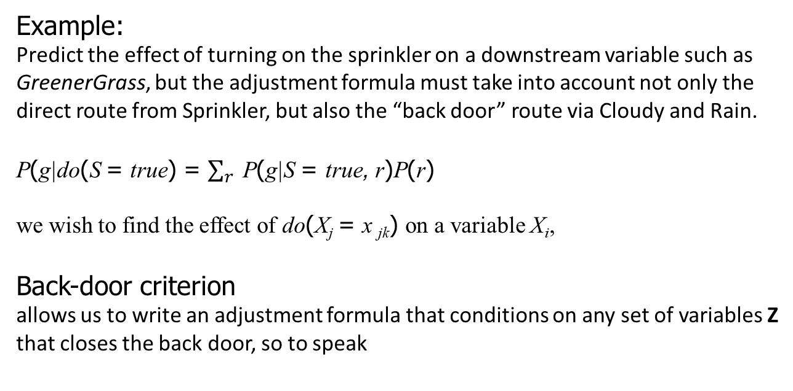
Causal Networks
Example:
Predict the effect of turning on the sprinkler on a downstream variable such as GreenerGrass, but the adjustment formula must take into account not only the direct route from Sprinkler, but also the “back door” route via Cloudy and Rain.
P(g|do(S = true) = $\sum_{r}{ }$P(g|S = true, r)P(r)
we wish to find the effect of do(X_{j} = x _{jk}) on a variable X_{i},
Back-door criterion
allows us to write an adjustment formula that conditions on any set of variables Z that closes the back door, so to speak

Slide 65
Summary
Bayes nets provide a natural representation for (causally induced) conditional independence
Topology + CPTs = compact representation of joint distribution Generally easy for (non)experts to construct
Canonical distributions (e.g., noisy-OR) = compact representation of CPTs Continuous variables ⇒ parameterized distributions (e.g., linear Gaussian)
Exact inference by variable elimination:
polytime on polytrees, NP-hard on general graphs
space = time, very sensitive to topology
Random sampling techniques such as likelihood weighting and Markov chain Monte
Carlo can give reasonable estimates of the true posterior probabilities in a network and can cope with much larger networks than can exact algorithms.
© 2022 Pearson Education Ltd.

